Slide 1
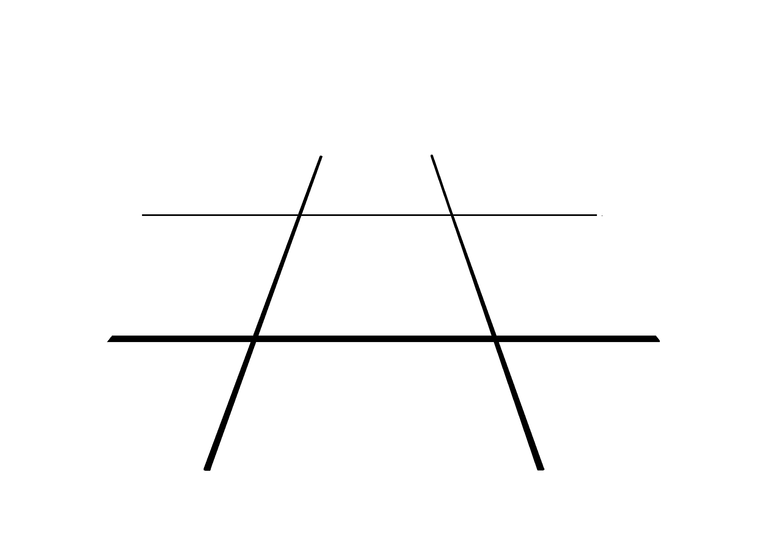
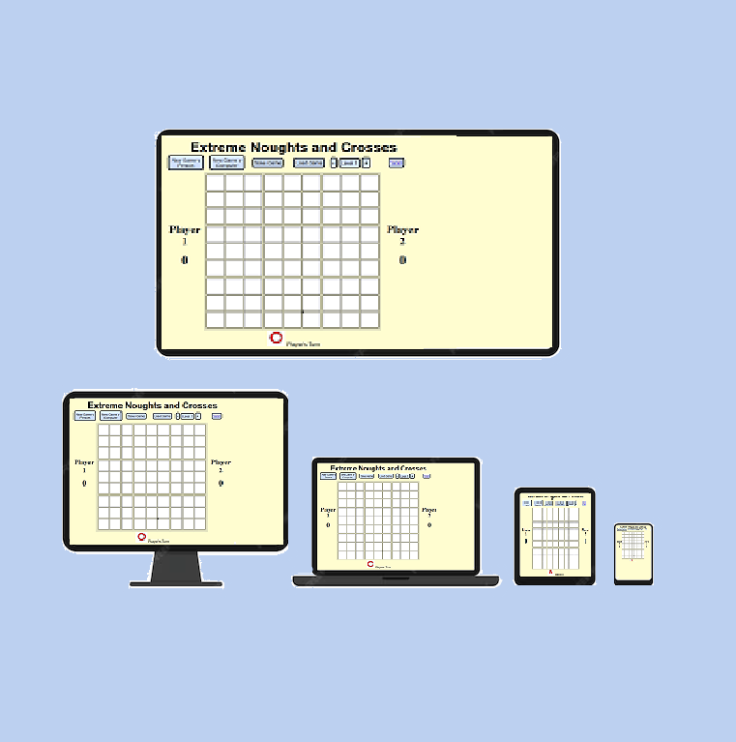
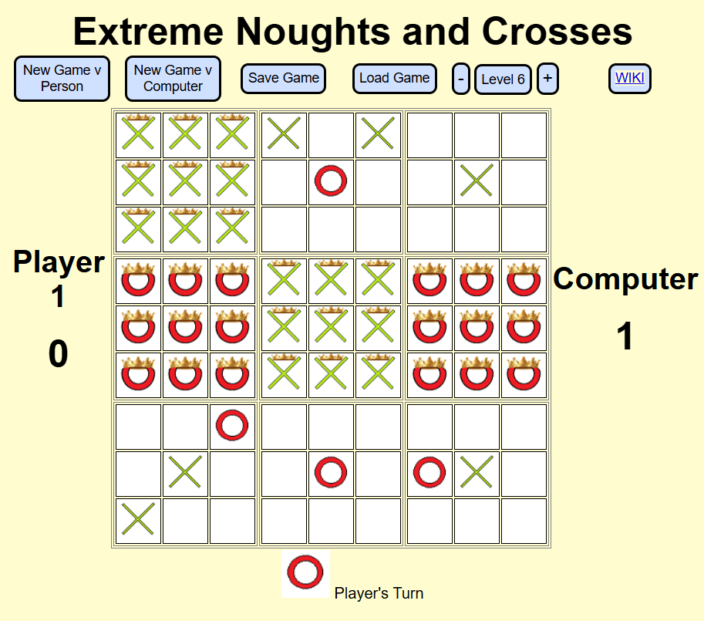
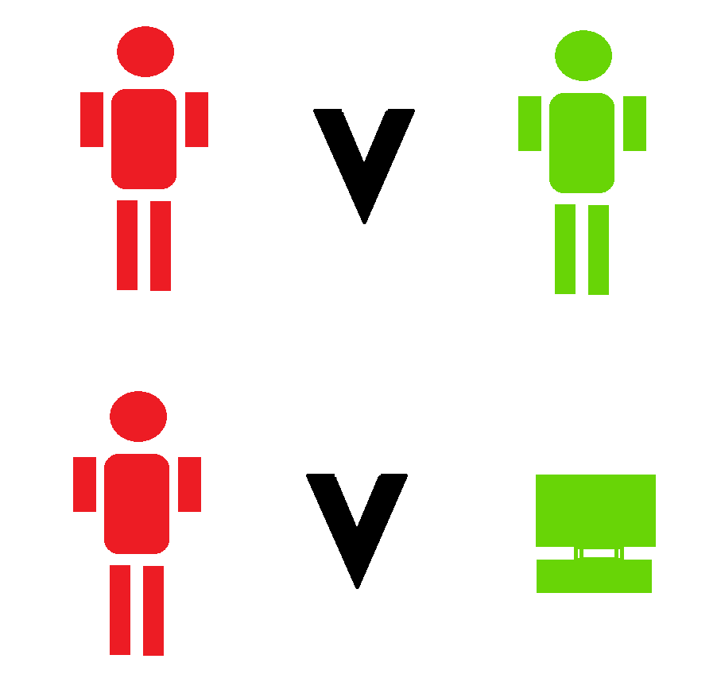


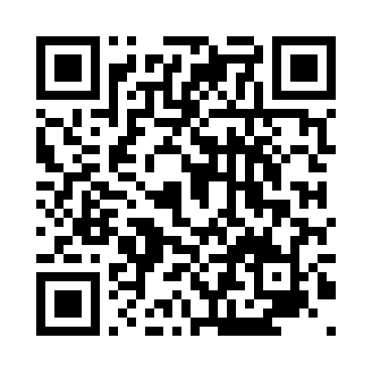
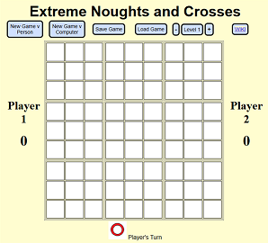
Extreme Noughts & Crosses
Project Overview
Suggested by staff and pupils Eat That Frog (eatthatfrog.ac.uk), a specialist post-16 institution, the app was to incorporate 9 mini games of Noughts & Crosses within a larger game of Noughts & Crosses to achieve a game which worked on many levels, where pupils could play on their own or against a tutor during 1-2-1 sessions. The colour scheme was to be dyslexia friendly as per the “Dyslexia friendly style guide” the British Dyslexia Association (www.bdadyslexia.org.uk) and was to be built using JavaScript, CSS and HTML only.
Future development
Further levels to be introduced
Instructions / Multilingual support
Auto complete for games that are draws
Remote player capability
User Customisations of names, colours, symbols
Features
Web based to work on multiple device type
Play against local player or against the computer with 6 levels of difficulty
Load and Save game with score and gameplay duration
Visual indicator whose turn is next
Link to WIKI page for TicTacToe (US name for Noughts&Crosses)
Grid size is adjustable
Dyslexia friendly appearance.
martin.bath@students.plymouth.ac.uk
Made With
BSc(Hons) Computing Science (2025)
Play the game
online-qr-generator.com
Logos courtesy of pngegg.com

